Slide 1

Asymptotic Notation Complexity Analysis
Week-02, Lecture-01
Course Code: CSE221
Course Title: Algorithms
Program: B.Sc. in CSE
Course Teacher: Tanzina Afroz Rimi
Designation: Lecturer
Email: tanzinaafroz.cse@diu.edu.bd

Slide 2
ALGORITHM DEFINITION
A finite
set of statements that guarantees
an optimal
solution in finite interval of time

Slide 3

GOOD ALGORITHMS?
Run in less time
Consume less memory
But computational resources (time complexity) is usually
more important

Slide 4
MEASURING EFFICIENCY
The efficiency of an algorithm is a measure of the amount of
resources consumed in solving a problem of size n.
The resource we are most interested in is time
We can use the same techniques to analyze the consumption of other
resources, such as memory space.
It would seem that the most obvious way to measure the
efficiency of an algorithm is to run it and measure how much
processor time is needed
Is it correct ?

Slide 5
FACTORS
Hardware
Operating System
Compiler
Size of input
Nature of Input
Algorithm
Which should be improved?

Slide 6
RUNNING TIME OF AN ALGORITHM
Depends upon
Input Size
Nature of Input
Generally time grows with size of input, so running time of an
algorithm is usually measured as function of input size.
Running time is measured in terms of number of
steps/primitive operations performed
Independent from machine, OS

Slide 7
FINDING RUNNING TIME OF AN
ALGORITHM / ANALYZING AN
ALGORITHM
Running time is measured by number of steps/primitive
operations performed
Steps means elementary operation like
,+, *,<, =, A[i] etc
We will measure number of steps taken in term of size of
input

Slide 8
SIMPLE EXAMPLE (1)
// Input: int A[N], array of N integers
// Output: Sum of all numbers in array A
int Sum(int A[], int N)
{
int s=0;
for (int i=0; i< N; i++)
s = s + A[i];
return s;
}
How should we analyse this?

Slide 9
SIMPLE EXAMPLE (2)
// Input: int A[N], array of N integers
// Output: Sum of all numbers in array A
int Sum(int A[], int N){
int s=0;
1
for (int i=0; i< N; i++)
2
3
4
s = s + A[i];
5
6
7
return s;
}
8
1,2,8: Once
3,4,5,6,7: Once per each iteration
of for loop, N iteration
Total: 5N + 3
The complexity function of the
algorithm is : f(N) = 5N +3
9

Slide 10
SIMPLE EXAMPLE (3) GROWTH
OF 5N+3
Estimated running time for different values of N:
N = 10
N = 100
N = 1,000
N = 1,000,000
=> 53 steps
=> 503 steps
=> 5003 steps
=> 5,000,003 steps
As N grows, the number of steps grow in linear proportion to N for
this function “Sum”

Slide 11
WHAT DOMINATES IN PREVIOUS
EXAMPLE?
What about the +3 and 5 in 5N+3?
As N gets large, the +3 becomes insignificant
5 is inaccurate, as different operations require varying amounts of time and
also does not have any significant importance
What is fundamental is that the time is linear in N.
Asymptotic Complexity
: As N gets large, concentrate on the
highest order term:
 Drop lower order terms such as +3
 Drop the constant coefficient of the highest order term i.e. N

Slide 12
ASYMPTOTIC COMPLEXITY
The 5N+3 time bound is said to "grow asymptotically"
like N
This gives us an approximation of the complexity of the
algorithm
Ignores lots of (machine dependent) details, concentrate
on the bigger picture

Slide 13
COMPARING FUNCTIONS:
ASYMPTOTIC NOTATION
Big Oh Notation: Upper bound
Omega Notation: Lower bound
Theta Notation: Tighter bound

Slide 14
BIG OH NOTATION [1]
If f(N) and g(N) are two complexity functions, we say
f(N) = O(g(N))
(read "f(N) is order g(N)", or "f(N) is big-O of g(N)")
if there are constants c and N such that for N > N ,
f(N) ≤ c * g(N)
for all sufficiently large N.

Slide 15
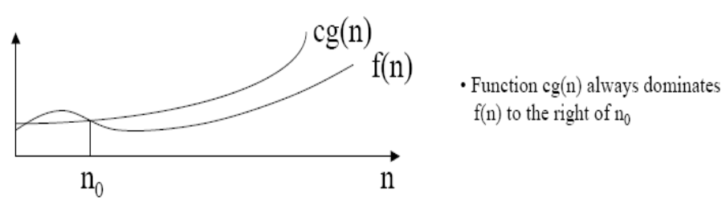
BIG OH NOTATION [2]

Slide 16
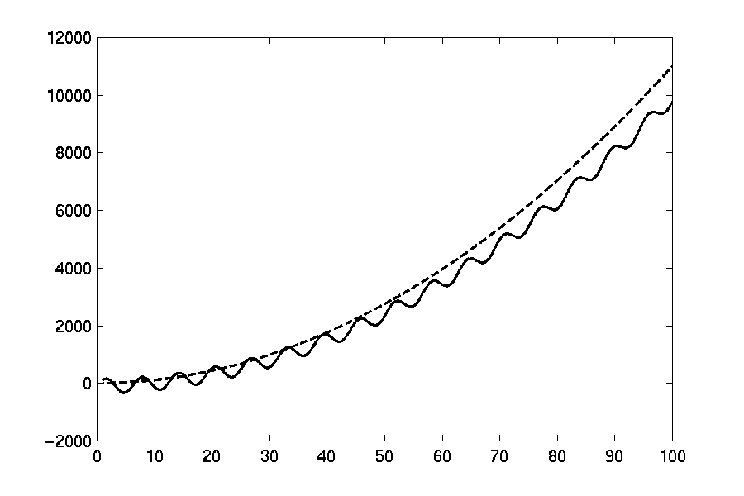

O(F(N))
16

Slide 17
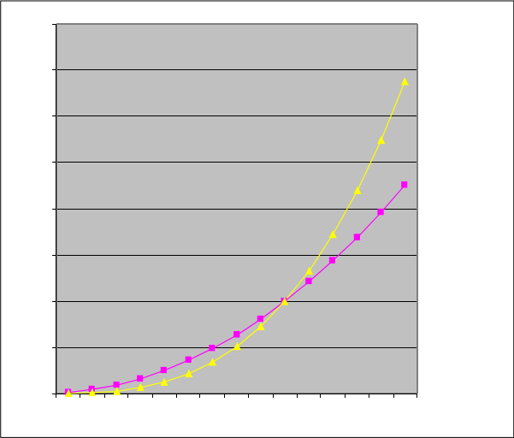


EXAMPLE (2): COMPARING
FUNCTIONS
○
Which function is better?
4000
10 n Vs n
2
3
3500
3000
2500
2000
10 n^2
n^3
1500
1000
500
0
1
2
3
4
5
6
7
8
9 10 11 12 13 14 15
17

Slide 18
COMPARING FUNCTIONS
As inputs get larger, any algorithm of a smaller order
will be more efficient than an algorithm of a larger order
0.05 N = O(N )
2
2
3N = O(N)
Time (steps)
Input (size)
N = 60
18

Slide 19
BIG-OH NOTATION
Even though it is correct to say “7n - 3 is O(n )”, a better
statement is “7n - 3 is O(n)”, that is, one should make the
approximation as tight as possible
3
Simple Rule:
Drop lower order terms and constant factors
7n-3 is O(n)
8n log n + 5n + n is O(n2 log n)
2
2

Slide 20
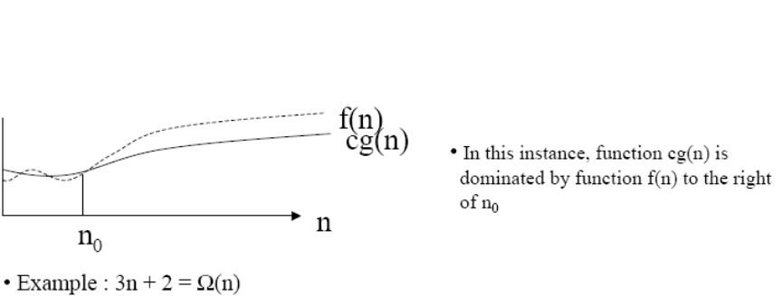
BIG OMEGA NOTATION
If we wanted to say “running time is at least…” we use Ω
Big Omega notation, Ω, is used to express the lower bounds on a
function.
If f(n) and g(n) are two complexity functions then we can say:
f(n) is Ω(g(n)) if there exist positive numbers c and n such that 0<=f(n)>=cΩ (n) for all n>=n
0
0

Slide 21
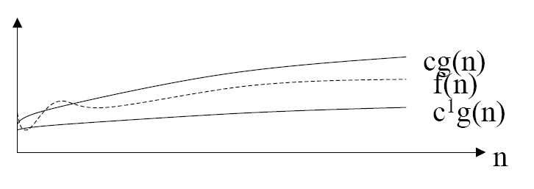
BIG THETA NOTATION
○
If we wish to express tight bounds we use the theta notation, Θ
○
f(n) = Θ(g(n)) means that f(n) = O(g(n)) and f(n) = Ω(g(n))
21

Slide 22
WHAT DOES THIS ALL MEAN?
If f(n) = Θ(g(n)) we say that f(n) and g(n) grow at the same
rate, asymptotically
If f(n) = O(g(n)) and f(n) ≠ Ω(g(n)), then we say that f(n) is
asymptotically slower growing than g(n).
If f(n) = Ω(g(n)) and f(n) ≠ O(g(n)), then we say that f(n) is
asymptotically faster growing than g(n).

Slide 23
WHICH NOTATION DO WE USE?
To express the efficiency of our algorithms which of the
three notations should we use?
As computer scientist we generally like to express our
algorithms as big O since we would like to know the
upper bounds of our algorithms.
Why?
If we know the worse case then we can aim to improve it
and/or avoid it.

Slide 24
PERFORMANCE CLASSIFICATION
f(n)
Classification
1
Constant
:
run time
is fixed,
and does
not depend upon n.
Most
instructions
are
executed once,
or
only a few times, regardless of the amount of information being processed
log n
Logarithmic
:
when
n
increases,
so does
run time,
but
much slower.
Common in programs
which
solve large problems by transforming them into smaller problems.
n
Linear
:
run time
varies
directly with
n
.
Typically,
a small amount
of processing is done
on each
element.
which break a problem
down into smaller sub-problems, solves them independently, then combines solutions
n log n
When
n
doubles,
run time
slightly more
than doubles.
Common in programs
n
2
Quadratic
:
when
n
doubles,
runtime
increases
fourfold.
Practical only for
small problems;
typically
the program processes all pairs of input (e.g. in a double nested loop).
n
3
Cubic
:
when n doubles,
runtime
increases
eightfold
2
n
Exponential
solution.
:
when n doubles,
run time
squares.
This is often the
result of
a natural, “brute
force”
24

Slide 25
SIZE DOES MATTER[1]
What happens if we double the input size N?
N
log N
5N
N log N
N
2
2
N
2
2
8 3 40
24 64 256
64 256 65536
16 4
80
32 5 160 160 1024 ~10
9
64 6 320 384 4096 ~10
128 7 640 896 16384 ~10
19
38
256 8 1280 2048 65536 ~10
76
25

Slide 26
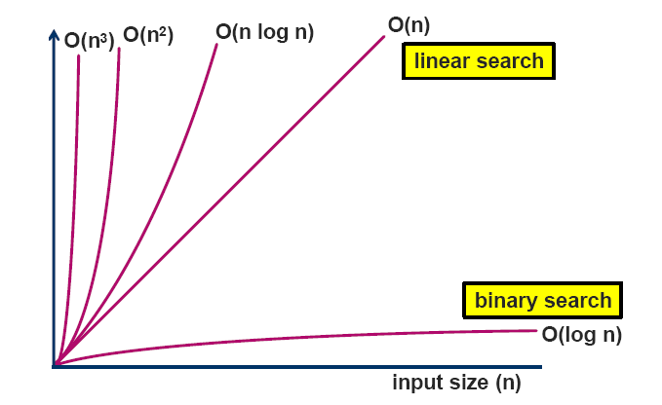
COMPLEXITY CLASSES
i T
t ( e m
) s p e s
26

Slide 27
SIZE DOES MATTER[2]
Suppose a program has run time O(n!) and the run time for
n = 10 is 1 second
For n = 12, the run time is 2 minutes
For n = 14, the run time is 6 hours
For n = 16, the run time is 2 months
For n = 18, the run time is 50 years
For n = 20, the run time is 200 centuries

Slide 28
Textbooks & Web References
Text Book (Chapter 3)
Reference book ii (Chapter 2)

Slide 29
Thank you
&
Any question?

